Slide 1


PANTOMATH ‘BO : DISCOVER CROSS MODAL HUMAN BEHAVIOR ANALYSIS
Vivekanand Education Society’s Institute Of Technology
Department Of Computer Engineering
Project Review 1
Group Members(Class,Roll no.)
D17C 58
D17C 67
D17C 68
D17C 72
Mentor Details:
Name: Sharmila Sengupta
Designation: Assistant Professor
Notes:
NOTE:
To change the image on this slide, select the picture and delete it. Then click the Pictures icon in the placeholder to insert your own image.

Slide 2
INDEX
Vivekanand Education Society’s Institute Of Technology
Department Of Computer Engineering

Slide 3
Index
Introduction
Lacuna in the Existing System
Problem Definition
Goals
Literature Survey
Methodology Applied
Specifications
Block Diagram
Conclusion
Reference

Slide 4
INTRODUCTION
Vivekanand Education Society’s Institute Of Technology
Department Of Computer Engineering

Slide 5
Introduction
Facial expression, hand gestures and body postures are closely linked to speech as they are used to enrich the vocal content and hence are multimodal in nature.
Nonverbal communication carries relevant information that can reveal social construct of a person as diverse as his personality, state of mind, or job interview outcome, they convey information in parallel to our speech.
This project deals with multimodal approach to the analysis of employment interviews and thereby recognising appropriate intent from the interviewee’s speech.

Slide 6
LACUNA IN THE EXISTING SYSTEM
Vivekanand Education Society’s Institute Of Technology
Department Of Computer Engineering

Slide 7
Lacuna In The Existing System
Existing System
Proposed System
While most existing studies rely on audio nonverbal cues (prosody, speaking turn-based features) or visual cues to predict personality, few studies have investigated the use of body communication.
Most systems have not used multi modal nature of communication to analyse and have been limited to only audio cues or video cues.
In the proposed system we plan to use cross modal nature of the communication to analyse the interview.
We use video cues, prosodic/audio cues as well as lexical/ language cues to analyse the interview.
And finally create a predictive model to rate the candidates and determine their hirability.

Slide 8
PROBLEM DEFINITION
Vivekanand Education Society’s Institute Of Technology
Department Of Computer Engineering

Slide 9
Problem Definition
To make an Expert System, a computational predictive framework that could analyse the candidate based on various communication cues and predict hirabiliy and rate different traits.
This system provides solution to identify the personality type characteristics of an interviewee and classification according to the levels exhibited in respective personality characteristic through facial expression recognition techniques along with vocal analysis to match with the personality characteristics of Passion, Cooperation, Confidence and Emotional Stability for job where high level of communication need to be done when performing the duties.

Slide 10
GOALS
Vivekanand Education Society’s Institute Of Technology
Department Of Computer Engineering

Slide 11
Goals Of The System
To make an Expert System that will aid the employer to select the best suitable candidate for the role.
It will analyse the candidate based on various communication cues.
Help with screening of applicant for jobs.
Help HR managers taking correct hiring decisions.

Slide 12
LITERATURE SURVEY
Vivekanand Education Society’s Institute Of Technology
Department Of Computer Engineering

Slide 13
Literature Survey
A. Work In Psychology
M. L. Knapp and J. A. Hall. Nonverbal communication in human interaction. Wadsworth, Cengage Learning, 7 edition, 2009.
Body communication plays an important role in conjunction with spoken words to enhance the communication in face-to-face interactions , which is also the case in employment interviews.
These kinesic nonverbal cues were also found to be associated with some personality dimensions. For instance, rapid body movement is shown to be related to extraversion and agreeableness, while relaxed body posture has been associated with conscientiousness .
N. Anderson and V. Shackleton. Decision making in the graduate selection interview: A field study. Occupational Psychology, 63(1):63– 76, 1990.
Highly employable job candidates usually produce more hand gestures, both in frequency and amplitude and have the tendency to lean forward more .

Slide 14
Literature Survey
B. Work In Computing
F. Pianesi, N. Mana, A. Cappelletti, B. Lepri, and M. Zancanaro. Multimodal recognition of personality traits in social interactions. In Proc. Int. Conf. on Multimodal Interactions, pages 53–60, New York, New York, USA, 2008. ACM Press.
The advent of cheap sensors, in combination with improved automated perceptual methods, have enabled the development of computational methods to predict social constructs .
2. J.-I. Biel and D. Gatica-Perez. The YouTube Lens: Crowd sourced Personality Impressions and Audiovisual Analysis of Vlogs. IEEE Transactions on Multimedia, 15(1):41–55, Jan. 2013.
As a key construct to explain inter-individual differences, Big-Five personality has been studied in various settings. These include small group interactions , video blogs or human-computer interaction .
3. L. Batrinca, N. Mana, B. Lepri, F. Pianesi, and N. Sebe. Please, tell me about yourself: automatic personality assessment using short self presentations. Proc. Int. Conf. on Multimodal Interactions, pages 255– 262, 2011.
While most existing studies rely on audio nonverbal cues (prosody, speaking turn-based features) and visual cues (head nods, visual activity, head pose) to predict personality, few studies have investigated the use of body communication.

Slide 15
METHODOLOGY APPLIED
Vivekanand Education Society’s Institute Of Technology
Department Of Computer Engineering

Slide 16
Methodology Applied
Data Collection
Setup
The mock interviews will be conducted in a room equipped with a desk, two chairs, and a camera .
The camera with microphones will capture the facial expressions and the audio conversations during the interview.
Participants
Juniors will participate in the mock interviews.
All participants will be native English speakers.
The interviews will be conducted by an experienced professor.
Procedure
Each interviewee will be asked ten predefined questions.
The ten questions will assess behavioral and social skills only.

Slide 17
Methodology Applied
Interview Questions:
Tell me about your self. (General)
Motivation for applying to the job. (General)
Past experience where communication skills were required. (Communication)
Past experience where persuasion skills were required. (Persuasion)
Past experience with role of responsibility. (Conscience)
Past experience where stress was correctly managed. (Stress Resistance)
What motivates you to do a good job. (Passion)
Explain why should I hire you. (Confidence)
How do you deal with people if you don’t like something about them. (Cooperation)
Wat are the things your friend would like you to improve. (Stability)
Tell me about a time when you demonstrated leadership skills. (Leadership)

Slide 18
Methodology Applied
Annotation Form:
The overall performance rating! (Overall rating)
How likely is the person to be hired? (Recommend Rating)
Did he use engaging tone? (Engagement)
Did he seem excited? (Excitement)
Did he maintained proper eye contact? (Eye Contact)
Did he smile appropriately? (Smile)
Did he seem Friendly? (Friendliness)
Speaking rate was good? (Speaking Rate)
Did he use too many filler words? (No fillers)
Did he pause appropriately? (Paused)
Did he seem authenticate? (Authentic)
12. Was he appear calm? (Calm)
13. Was he seem focused? (Focused)
14. Were his answers structured? (Structured)
15. Was he stressed? (Not Stressed)

Slide 19
Methodology Applied
Data labelling/annotation
To remove any kind of bias, some annotators will watch the interview videos and rate the performances of the interviewees by answering 16 assessment questions.
The questions about “Overall Rating” and “Recommend Hiring” represent the overall performance. The remaining questions have been selected to evaluate several high-level behavioural dimensions such as warmth (e.g., “friendliness”, “smiling”), presence (e.g., “engagement”, “excitement”, “focused”), competence (e.g. speaking rate), and content (e.g., “structured”).

Slide 20
Methodology Applied
Data analysis
Audio cues – using praat/pyaudio/audacity
For noise reduction and editing purposes Audacity – a free multitrack audio editor and recorder can be used.
We will extract prosodic features of the interviewee’s speech using the open-source speech analysis tool PRAAT.
The important prosodic features include the pitch information, vocal intensities, characteristics of the ﬁrst three formants, and spectral energy, which have been reported to reﬂect our social traits.
Video cues – using cv2, cnn , (emotions, head gestures, head nods )
We will extract facial features of the interviewees from each video frame.
We will also extract head gestures such as nods and shakes from each video frame, and treat their average values as features.

Slide 21
Methodology Applied
Data analysis
Text = using liwc,nlp/(sentiments)
Incorporating word counts often results in sparse high-dimensional feature vectors,and suffers from the “curse of dimensionality” problem, especially for a limited sized corpus.
Instead of using raw unigram counts, we can employ counts of various psycholinguistic word categories deﬁned by the tool “Linguistic Inquiry Word Count” (LIWC).
The LIWC categories include negative emotion terms (e.g., sad, angry), positive emotion terms (e.g., happy, kind) and various content word categories (e.g., anxiety, insight).

Slide 22
Methodology Applied
Classification / predictive framework – svm/lasso/DNN
Regression models will be trained to predict the interview scores and other interview-speciﬁc traits such as excitement, friendliness, engagement, awkwardness, etc.
We will try with different classification algorithm after interview collection like-
SVM –
The Support Vector Machine (SVM) is a widely used supervised learning method for classiﬁcation.
Lasso -
Lasso (least absolute shrinkage and selection operator) (also Lasso or LASSO) is a regression analysis method that performs both variable selection and regularization in order to enhance the prediction accuracy and interpretability of the statistical model it produces.

Slide 23
Methodology Applied
Classification / predictive framework – svm/lasso/DNN
DNN architectures generate compositional models where the object is expressed as a layered composition of primitives.
The extra layers enable composition of features from lower layers, potentially modelling complex data with fewer units than a similarly performing shallow network.

Slide 24
SPECIFICATIONS
Vivekanand Education Society’s Institute Of Technology
Department Of Computer Engineering

Slide 25
Hardware Specifications
Raspberry Pi kit
Camera
Microphone

Slide 26
Software Specifications
Python
Praat / Audacity

Slide 27
Tools
ML libraries
Tensorflow
Keras
CUDA Toolkit
PRAAT
Opencv

Slide 28
Constraints
Storage of raw data.
High storage demand.
High Computational Requirement.(GPUs)

Slide 29
BLOCK DIAGRAM
Vivekanand Education Society’s Institute Of Technology
Department Of Computer Engineering

Slide 30
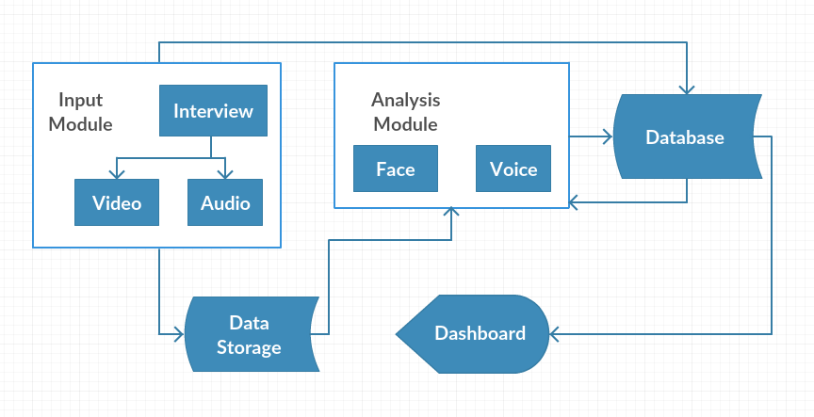
Block Diagram

Slide 31
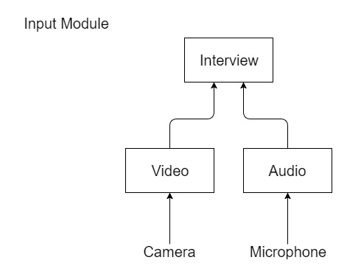
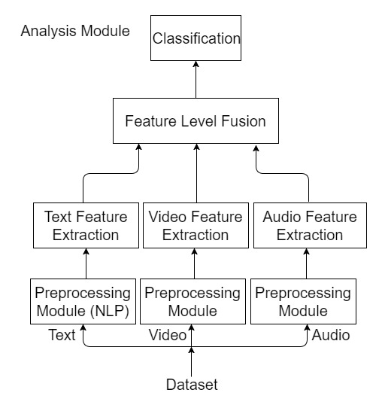
Block Diagram

Slide 32
DATA FLOW DIAGRAMS
Vivekanand Education Society’s Institute Of Technology
Department Of Computer Engineering

Slide 33
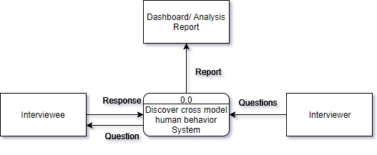
DFD Level 0

Slide 34
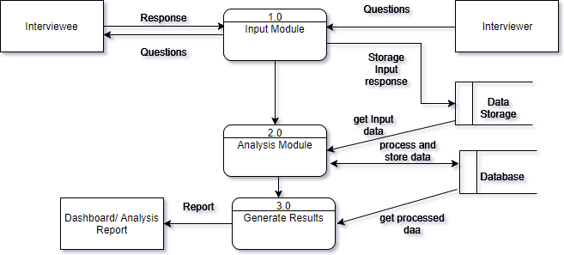
DFD Level 1

Slide 35
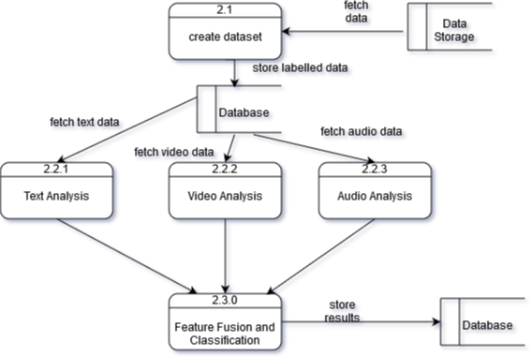
DFD Level 2

Slide 36
OTHER SPECIFICATIONS
Vivekanand Education Society’s Institute Of Technology
Department Of Computer Engineering

Slide 37
Other Specifications (if Any)

Slide 38
CONCLUSIONS
Vivekanand Education Society’s Institute Of Technology
Department Of Computer Engineering

Slide 39
Conclusion
This system conducts a systematic study on applicant’s body communication in job interviews with respect to hirability impressions and self-rated personality.
Our system is trained to predict ratings based on entire interview videos, and one has to wait till the end of the interview in order to receive feedback.
Real-time feedback will be shown for different individual traits on the interviewer dashboard.
Extending our prediction framework to provide fully autonomous real-time feedback can be an exciting future direction.

Slide 40
REFERENCES
Vivekanand Education Society’s Institute Of Technology
Department Of Computer Engineering
M. L. Knapp and J. A. Hall. Nonverbal communication in human interaction. Wadsworth, Cengage Learning, 7 edition, 2009.
N. Anderson and V. Shackleton. Decision making in the graduate selection interview: A field study. Occupational Psychology, 63(1):63– 76, 1990.
T. DeGroot and J. Gooty. Can Nonverbal Cues be Used to Make Meaningful Personality Attributions in Employment Interviews? Journal of Business and Psychology, 24(2):179–192, Feb. 2009.
F. Pianesi, N. Mana, A. Cappelletti, B. Lepri, and M. Zancanaro. Multimodal recognition of personality traits in social interactions. In Proc. Int. Conf. on Multimodal Interactions, pages 53–60, New York, New York, USA, 2008. ACM Press.
J.-I. Biel and D. Gatica-Perez. The YouTube Lens: Crowd sourced Personality Impressions and Audiovisual Analysis of Vlogs. IEEE Transactions on Multimedia, 15(1):41–55, Jan. 2013.
L. Batrinca, N. Mana, B. Lepri, F. Pianesi, and N. Sebe. Please, tell me about yourself: automatic personality assessment using short self presentations. Proc. Int. Conf. on Multimodal Interactions, pages 255– 262, 2011.
J. Curhan and A. Pentland. Thin slices of negotiation: Predicting outcomes from conversational dynamics within the first 5 minutes. Applied Psychology, 92(3):802, 2007.

Slide 41
THANK YOU
Vivekanand Education Society’s Institute Of Technology
Department Of Computer Engineering

